Slide 1

The Hawaii Growth Model
Next-Generation Design & Performance
Richard J. Wenning
The SchoolView® Foundation
Changing Conversations about Education®

Slide 2
Next-Generation Performance
Dramatic, not incremental improvements required for students that need to catch up to become college & career ready (CCR)
  From a system where most students that start behind stay behind to a system where they catch up
Implies that our accountability systems should provide information that fuels a consensus for change & capacity for improvement

Slide 3

Next-Generation Accountability Systems
Coherent systems focused on learning & building performance management capacity at all levels
  Maximize student progress toward & attainment of college and career readiness
  Support local ownership of high quality information to drive insight and action
Notes:
2.0 system is one that is coherent, focused on learning and building PM capacity; Focused on max progress to CCR...
Local, personal ownership will be more likely if we use coherent and collaborative design principles.

Slide 4
Policy Perspective on Growth
Why is measuring student growth so important?
  NCLB (Accountability 1.0) had right intent but…
    AYP metric not useful for school performance management
    Incentives focused on short-term increases in percent proficient, on “bubble” kids, invited moral hazard
    Instead of long-term effectiveness and progress for all kids toward college & career readiness
  ESEA waivers & design of educator effectiveness systems provides opportunity to get the measures & incentives right

Slide 5


Next-Generation
Accountability Systems
What can we learn from Moneyball?
In Moneyball, Peter Brand shares a key insight with Billy Beane, the GM of the Oakland A’s…
Notes:
How many have you seen teh movie?

Slide 6


Slide 7
Moneyball & Public Education
There is an epidemic failure within education to understand what is really happening and this leads people who run school systems to misjudge their students and educators and mismanage their schools and districts
Notes:
.Where is this most apparent? In the area we have the most control. Measuring student progress.

Slide 8
Speedometers & Mile Markers
Rate x Time = Distance
Consider two buses heading to the same destination but starting from different places…..
http://www.youtube.com/watch?v=AN04rc5crXw&feature=plcp
Notes:
Consider the role of the speedometer in your car and the mile markers along the highway… remember the basic formula….

Slide 9
Understanding Performance
High
High Status
Low Growth
High Status
High Growth
Achievement
Status
Low Status
Low Growth
Low Status
High Growth
Low
Low
Longitudinal Growth
High

Slide 10

Coherent Design Serves Multiple Purposes
Notes:
What do our users need?

Slide 11
Coherent Design Serves Multiple Purposes
External Accountability Purposes: Public, Fed, State, District
Evaluation Purposes
(judgments)
Inquiry Purposes
(perspectives)
Internal Improvement Purposes: School, Educator, Student

Slide 12
What Models?
What statistical models of longitudinal student growth will promote the most coherence and alignment in our accountability system?

Slide 13
Questions Set the Table
Growth models address specific questions
  Different techniques are good at answering different questions
  Different questions lead to different conversations which lead to different uses and outcomes
  Starting with the right questions simplifies development and motivates the proper use of the growth model results

Slide 14
Some Framing Ideas
We understand best those things we see emerge from their very beginnings.
- Aristotle
All Models are wrong but some are useful.
- George E. P. Box
It is better to have an approximate answer to the right question than a precise answer to the wrong question.
- John Tukey

Slide 15
How much growth did a student make & is it good enough?
Describing growth versus ascribing responsibility
  The Colorado Growth Model began by separating the description of growth from discussions of responsibility/ accountability
  Incorporating growth into accountability followed from the accepted description of growth
  The description of growth facilitated stakeholder engagement and investigations of responsibility for good/bad growth
  That in turn led to greater stakeholder support

Slide 16
Describing Student Growth
Discussing student growth, even with a vertical scale, is not a simple task
Growth and change require context. Consider, for example, height:
  A child might grow 4 inches between ages 3 and 4
    4 inches is a well understood quantity
  The 4 inch increase becomes meaningful only when understood alongside the growth of other 3 to 4 year olds
Student growth percentiles were developed to provide a norm-referenced basis for describing student growth

Slide 17
Who/What is Responsible for
Student Growth?
Some analyses of student growth attempt to determine the amount of student progress that can be attributed to the school or teacher
  Called value-added analyses, these techniques attempt to estimate the teacher/school contribution to student academic growth
Value added is an inference – a causal conclusion drawn from the data
All growth models can be used for value-added purposes

Slide 18
Student Growth Percentile Model
What is?
What should be?
What could be?
How much growth did a child make in one year?
How much growth is enough to reach college & career readiness?
How much growth have other students made with the same starting point?

Slide 19
Student Growth Percentiles
Should we be surprised with a child’s current achievement given their prior achievement?
  Student growth percentiles answer this question
Consider a low achieving student with 90th percentile growth and a high achieving student with 10th percentile growth
  The low achieving student grew at a rate exceeding 90 percent of similar students
  The high achieving student grew at a rate exceeding just 10 percent of similar students
  The low achiever’s growth is more exemplary than the high achiever’s
Judgments about the adequacy of student growth require external criteria together with standard setting

Slide 20
Establishing Growth Standards
Based on Growth Norms
The most common adequacy criterion is judging growth toward an achievement goal (i.e., growth-to-standard)
Results from student growth percentile analyses can be used to calculate growth trajectories for each student
These trajectories indicate what future rates of growth will lead to and are used to make adequacy judgments
This growth-to-standard approach was approved as part of Colorado’s successful application to the Growth Model Pilot Program and ESEA Flexibility Request

Slide 21
Understanding Student Growth Percentiles
Academic Peers
+
=
(
)
Student
Growth
Percentile
Low
High
Typical
My prior CSAP
Achievement
Prior Year
CSAP Achievement
My Growth Compared
to My Academic Peers
What is Student Adequate Growth Percentile (AGP)?
+
+
=
Adequate
Growth
Percentile
3 Years or
By Grade 10*
My Prior CSAP
Achievement
Distance to or from Proficiency
*Whichever comes first.

Slide 22
Summary: SGPs Measure…
Each student’s norm- and criterion-referenced progress compared to other students in the state with similar score history on statewide and interim assessments
The adequacy of Individual year-to-year and shorter cycle student progress toward state standards
The growth rate needed for groups of students to catch up or keep up to be on track to reach college and career readiness
Norm- and criterion-referenced growth rates among different groups of students at the state, district, school, and classroom levels
Statewide and cross-state growth benchmarks for schools, districts, and education service providers

Slide 23
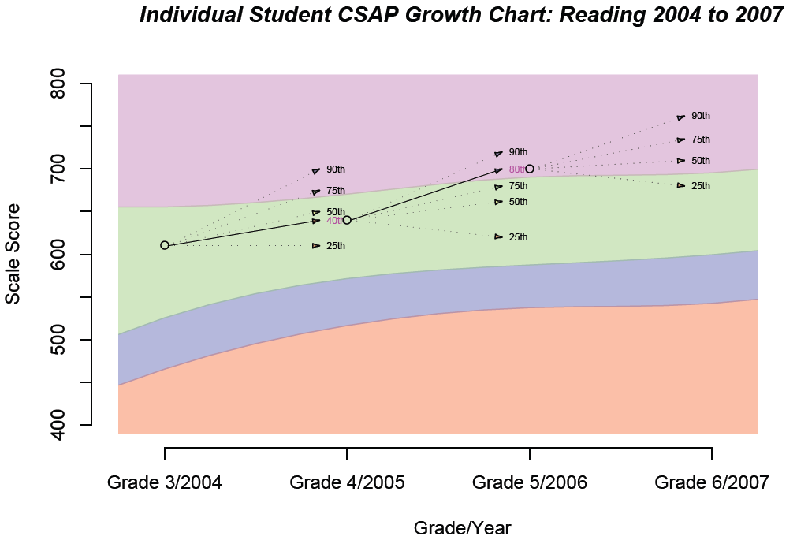

Slide 24
One Student’s Growth Percentiles

Slide 25
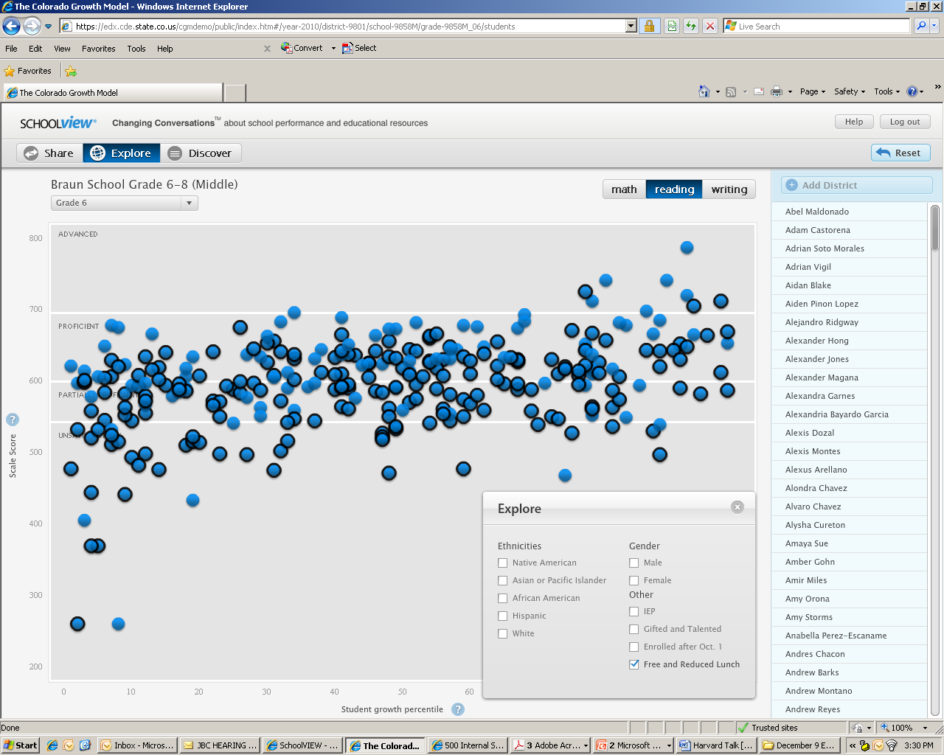
Students within a Grade
Notes:
And here we are looking at students in a single grade in a single school

Slide 26
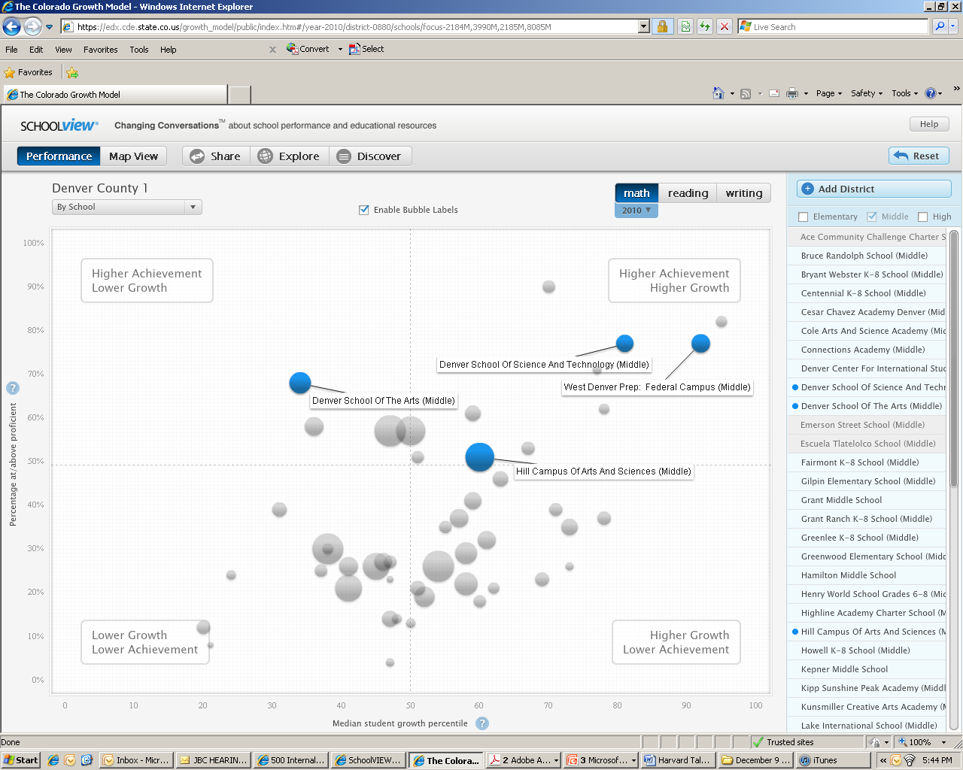
Schools within a District

Slide 27
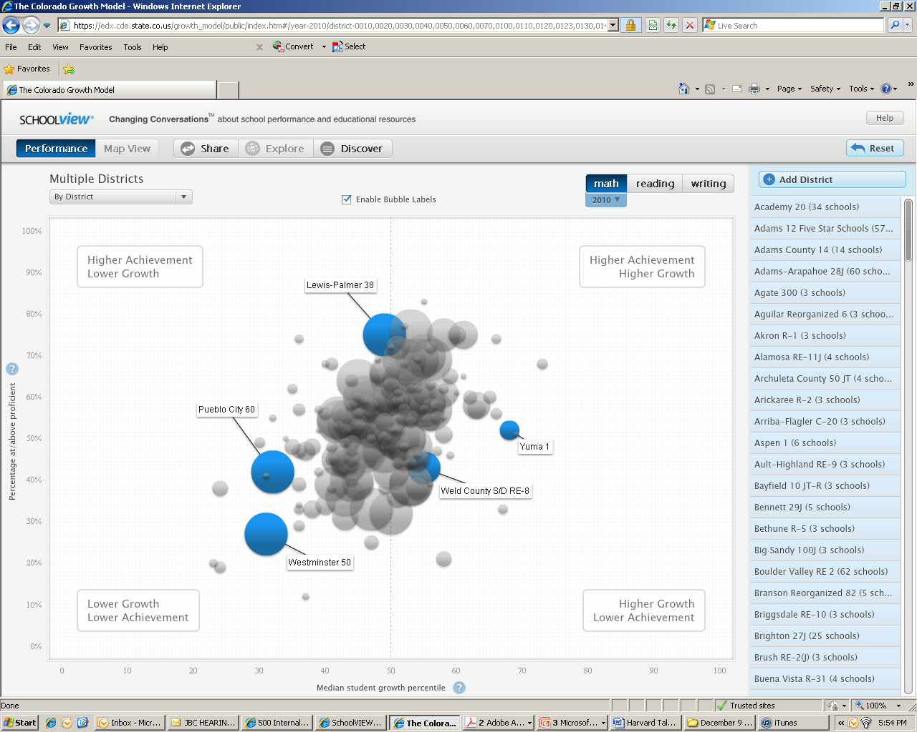
Districts within a State

Slide 28
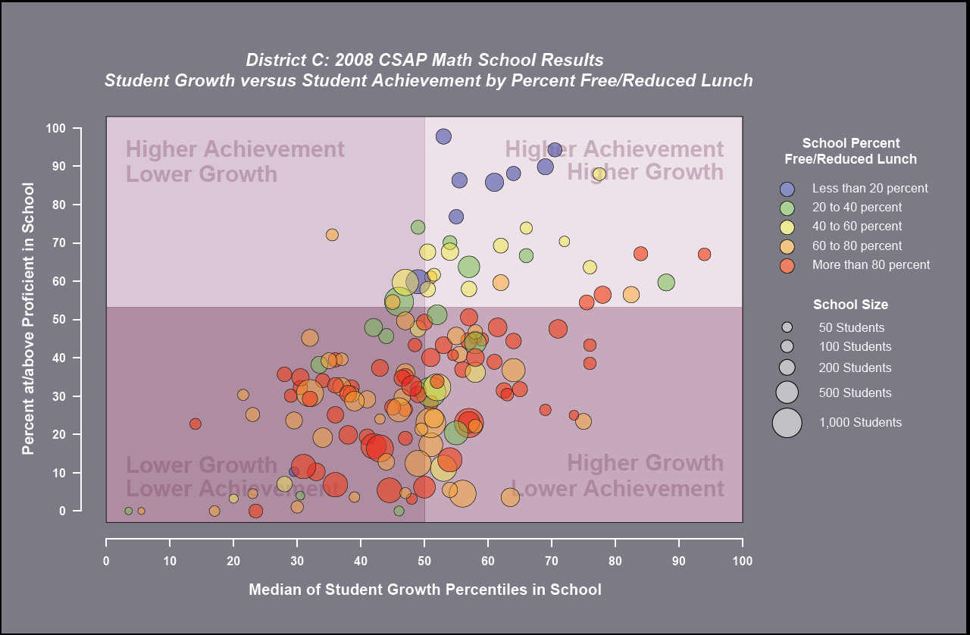
Notes:
Here we are looking at schools in a single district

Slide 29
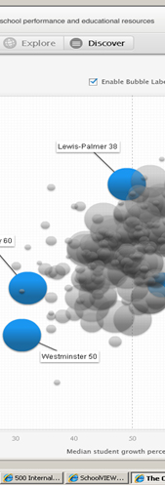
Open Code & Collaboration
19 states have signed an MOU to share the Student Growth Percentile methodology and SchoolView® display tools:
  Arizona, Colorado, Georgia, Hawaii, Idaho, Indiana, Kansas, Massachusetts, Missouri, Nevada, New Hampshire, New York, Oregon, Rhode Island, Virginia, Washington, West Virginia, Wisconsin, Wyoming
Notes:
Our goal in sharing the code freely among states is to promote learning and improvements through collaboration

Slide 30
Contact Information
Richard J. Wenning
President & Co-Founder
The SchoolView Foundation
PO Box 1508, Dillon, CO 80435
rwenning99@gmail.com
303.601.7454

